Slide 1
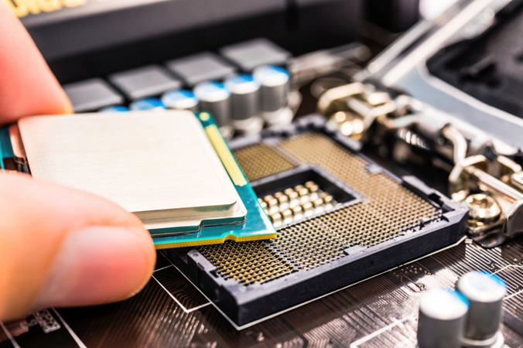
IT Essentials (CompTIA A+) Ch. 3 Microprocessors
Notes:
Charles Babbage was a mathematician in the nineteenth century, a time well before anyone thought to create electronic calculators or computers. Babbage thought of making machines that would do calculations mechanically, so the numbers would always be right. Although his ideas were ahead of his time, inventors in the mid-twentieth century picked up the concepts and created huge calculating machines that they called computers.

Slide 2
Overview
Central Processing Unit (CPU) core components
Memory and RAM
Modern CPU(s)
Select and install a CPU
Troubleshoot a CPU

Slide 4
CPU Core Components
The central processing unit (CPU) works as a very powerful calculator.
The CPU’s processing speed makes it appear to be intelligent.
Notes:
Discussion Point
Electrostatic Discharge
Recall from the first lesson in Chapter 2 the issues concerned with electrostatic discharge (ESD), and the precautions that need to be taken when handling components. Try to reinforce this concern throughout the course.

Slide 5
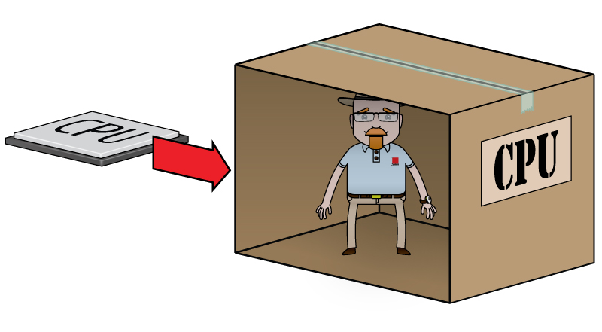
CPU Core Components
Visualize the CPU as a man in a box.
He will gladly perform anything you want him to do, but he can't see or hear anything outside the box.
Figure 4.1 Imagine the CPU as a man in a box.
Notes:
To think about how the CPU works, let’s use an analogy . . .
Picture a man in a box, a mathematical genius, but sealed in a box. We need some way to communicate with him.

Slide 6
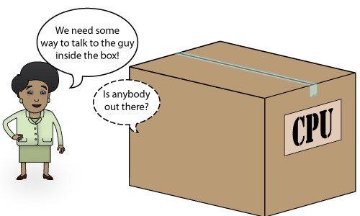
CPU Core Components
Figure 4.2 How do we talk to the Man in the Box?
Notes:
Before he can work with us, we must come up with a way to exchange information with him (see Figure 4.2).

Slide 7
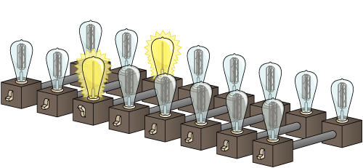
CPU Core Components
Imagine 16 lights
8 on the inside and 8 on the outside (8 bits = 1 Byte)
When an inside light is on, the corresponding outside light is on.
Lights may be switched on or off from either side.
Communication device is called the external data bus (EDB).
Figure 4.3 Cutaway of the external data bus—note that one light bulb pair is on.
Notes:
Idea: drill holes and put wires through with lights and switches on either side. Then we can use patterns of on and off to communicate—as long as both we and the man in the box understand the code, we can communicate.
Figure 4.3 shows a cutaway view of the external data bus. When either you or the man in the box flips a switch on, both light bulbs go on, and the switch on the other side is also flipped to the on position. If you or the man in the box turns a switch off, the light bulbs on both sides are turned off, along with the other switch for that pair.

Slide 8
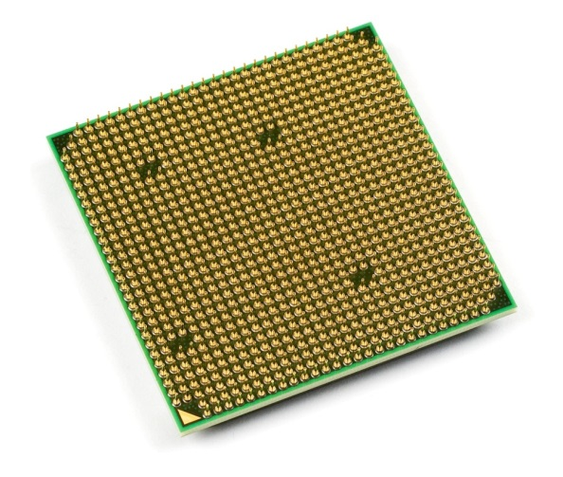
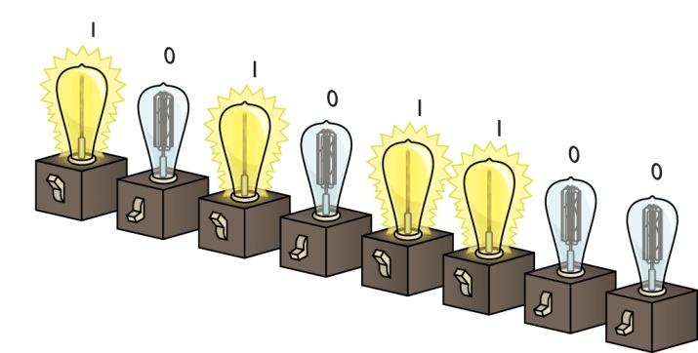
CPU Core Components
In reality, there are no bulbs, only little wires that connect to the EDB allowing the CPU to communicates with the outside world.
Voltage is either applied or not, “on-off-on-off-on-on-off-off” is translated as binary, “10101100” to a CPU. (1 is on, 0 is off)
Figure 4.5 Here "1" means on,
"0" means off.
Figure 4.4 Close-up of the underside of a CPU
Notes:
In the world of computers, we constantly turn wires on and off. As a result, we can use this “1 and 0” or binary system to describe the state of these wires at any given moment.

Slide 9
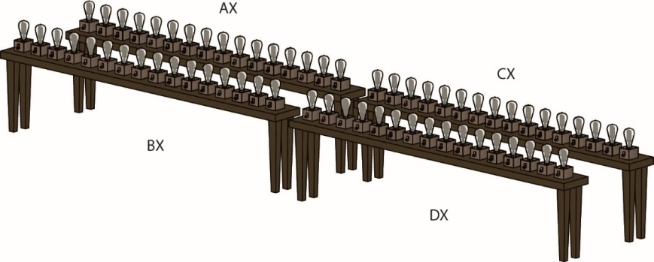
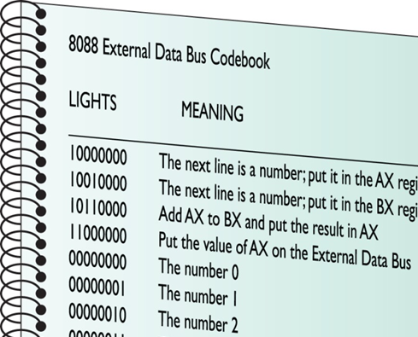
CPU Core Components
Inside the box are registers, represented as worktables for the Man in the Box.
There are 4 general-purpose registers in all CPUs (AX, BX, CX, and DX).
The Man in the Box needs
one more tool: the codebook or instruction set.
The commands are called machine language.
Instruction sets are the
commands for a CPU.
Notes:
In reality, the general-purpose registers are 32 “light bulbs” wide and are called EAX, EBX, ECX, and EDX, but for the sake of analogy, these older registers are perfectly fine.

Slide 10
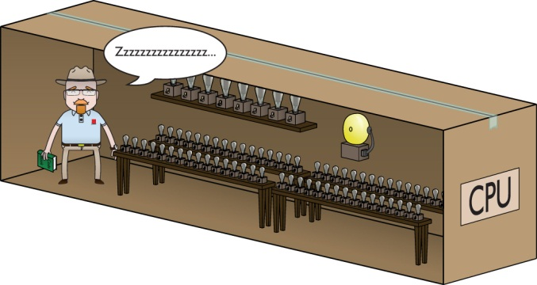
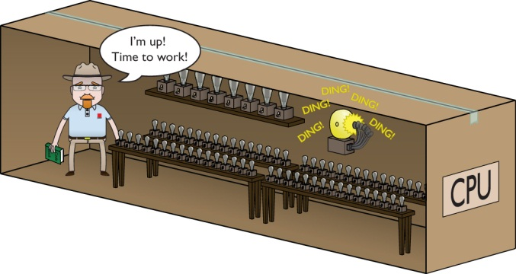
CPU Core Components
The CPU does no work until told to—even though data may be on the EDB.
You need a bell to alert the Man in the Box.
This is referred to as a clock wire (CLK wire)
A charge on the CLK wire tells the CPU it is time to work.
Figure 4.9 The CPU does nothing until activated by the clock.
Figure 4.10 The CPU often needs more than one clock cycle to get a result.

Slide 11
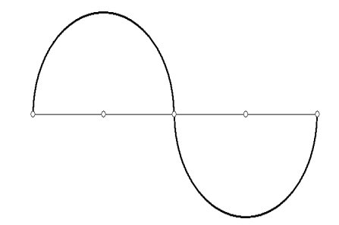
CPU Core Components
A clock cycle is the time it takes for the CLK wire to charge.
A cycle is one complete up-and-down segment of the sine wave.
Every command requires at least two clock cycles.

Slide 12
CPU Core Components
Clock speed is the maximum number of clock cycles the CPU can handle in a given time period.
Clock speed is measured in hertz
One cycle per second = 1 hertz (Hz) 1 million cycles per second = 1 megahertz (MHz) 1 billion cycles per second = 1 gigahertz (GHz)
Intel 8088 ran at 4.77 MHz
Modern CPUs run at 3+ GHz
Notes:
Commands require from two to hundreds of clock cycles to be processed.
The Intel 8088 ran at 4.77 MHz (4.77 million cycles per second). Today’s CPUs run at several gigahertz.
CPU makers sell the exact make and model of CPU at a number of different speeds. All of these CPUs come off the same assembly lines, so why different speeds? Every CPU comes with subtle differences—flaws, really—in the silicon that make one CPU run faster than another. The speed estimate comes from testing each CPU to see what speed it can handle.

Slide 13
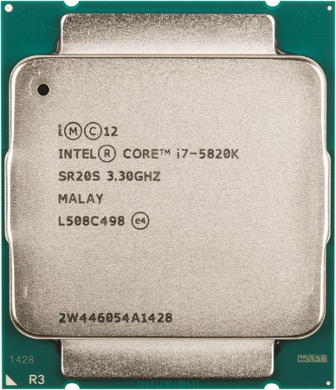
CPU Core Components
Figure 4.11 Where is the clock speed?
Notes:
Manufacturers used to print the CPU’s clock speed directly onto the CPU, but for the past few years they’ve used cryptic codes (see Figure 4.11).

Slide 14
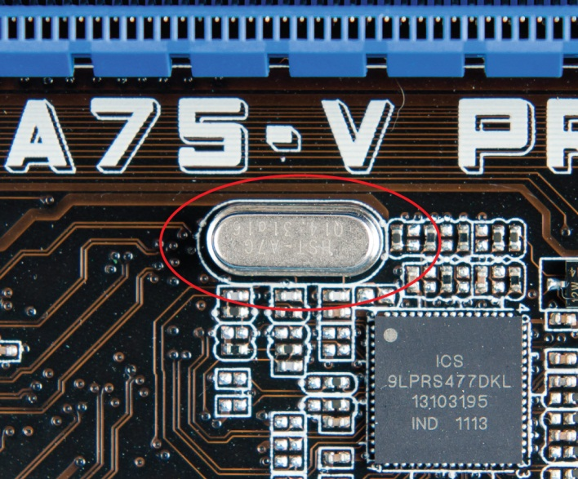
CPU Core Components
System crystal governs CPU running speed
Modern CPUs tell the motherboard the clock speed it needs, and the clock chip automatically adjusts.
Figure 4.12 One of many types of system crystals
Notes:
The name crystal is actually short for crystal oscillator. When a voltage is applied to a specially cut crystal (such as quartz), it will oscillate with surprising accuracy. This produces a pulse that is used to “clock” the CPU. Crystals can be cut to produce clocks at almost any speed. The speed of the crystal’s clock determines the speed at which the CPU will operate.

Slide 15
CPU Core Components
Crystal can clock a CPU with a rated speed higher than the crystal, but the CPU will operate at the slower speed of the crystal.
A 1 GHz crystal can clock a 2 GHz CPU, but the CPU will operate only as fast as the crystal clock—1 GHz.
Underclocking or Throttling means running a CPU slower than its rated clock speed—it does not take advantage of all the power of the CPU.
Overclocking means to run a CPU faster than its maximum clock speed—it can overheat the CPU.
Notes:
This might be a good time to have the students locate the system crystal on their motherboards.
Be careful, as most motherboards have lots of crystals.

Slide 16

CPU Core Components
Notes:
This might be a good time to have the students locate the system crystal on their motherboards.
Be careful, as most motherboards have lots of crystals.

Slide 17
Memory and RAM
Random access memory (RAM) is organized like a spreadsheet, with each row holding eight bits (or one Byte (B)). A bit (b) is a 1 or 0.
RAM transfers and stores data to and from the CPU in Byte-sized chunks
Number of Bytes of RAM varies from PC to PC, with today's PCs holding billions of bytes of RAM
Notes:
RAM is volatile—it zeros out when power is lost.

Slide 18
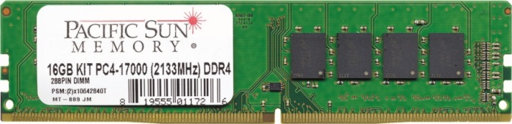
Memory and RAM
Computers use dynamic RAM (DRAM) for main memory (volatile)
Dynamic rather than static
Dynamic circuits need constant electrical charge and to be refreshed to maintain data.
Static RAM is faster, more expensive and is non-volatile.
Used as cache memory
Figure 4.15 Typical RAM

Slide 19
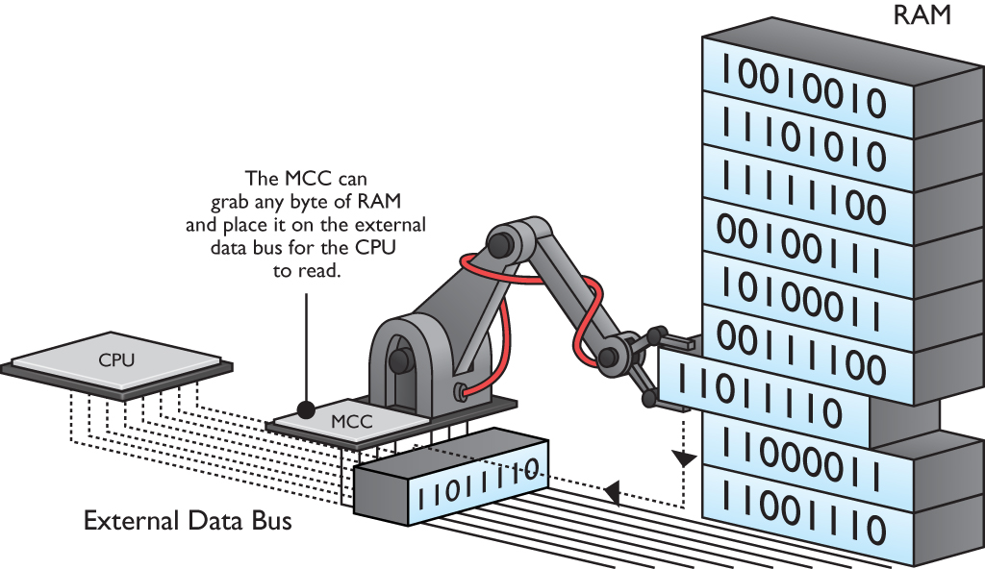
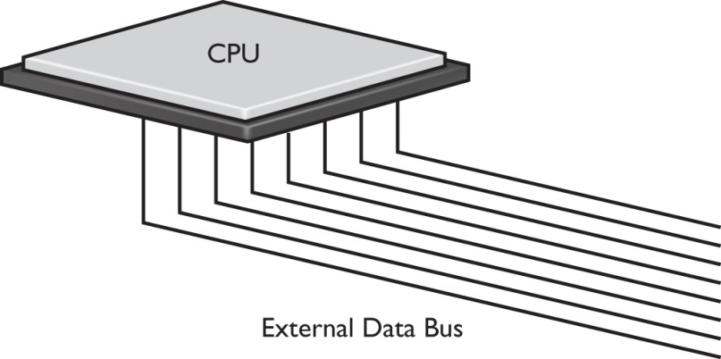
Memory and RAM
CPU and RAM communicate through EDB.
The CPU needs a helper chip—the memory controller chip (MCC) to facilitate the flow of data from RAM to the CPU.
The EDB and MCC can
Figure 4.16 Extending the EDB
Figure 4.17 The MCC grabs a byte of RAM.
Notes:
So far, the entire PC consists of only a CPU and RAM. But the CPU and the RAM need some connection so they can talk to each other. To do so, extend the external data bus from the CPU so it can talk to the RAM (see Figure 4.16).
The MCC contains special circuitry so it can grab the contents of any single line of RAM and place that data or command on the EDB. This in turn enables the CPU to act on that code (see Figure 17)

Slide 20
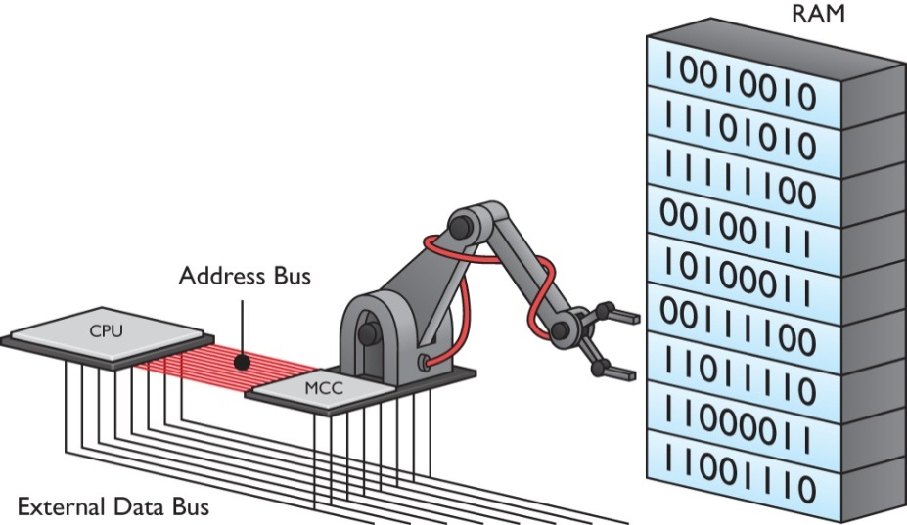
Memory and RAM
The address bus is a separate set of wires from the external data bus.
Enables the CPU to control
the MCC
CPU tells the MCC which line
of code it wants from RAM
Figure 4.18 Address bus

Slide 21
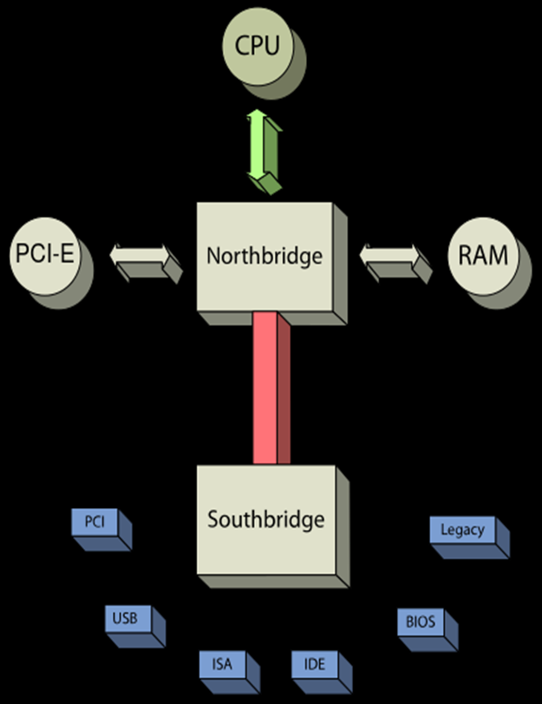
Memory and RAM
FSB
Think of the EDB as part of the Front Side Bus (FSB)
Think of the MCC as part of the North Bridge
The number of wires in the address bus determines the maximum amount of RAM the CPU can handle.
EDB
MCC

Slide 22
Memory and RAM

Slide 23
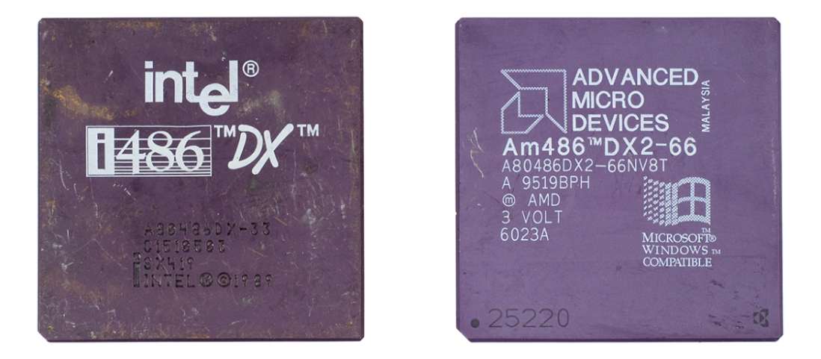
Modern CPUs
CPU Developers
Intel currently holds the most market share, AMD provides quality CPUs at competitive prices.
Early Intel and AMD CPUs were identical; but they are no longer interchangeable.
Figure 4.19 Identical Intel and AMD 486 CPUs from the early 1990s
Notes:
Modern CPUs retain the core structure of Intel 8088, including registers, instruction sets, and arithmetic logic unit. While modern processors share fundamental technology introduced by Intel, many differences prevent you from moving a CPU from one system to another.

Slide 24
Modern CPUs
Intel and AMD differentiate product lines by using different product names, based on the target market.
Table 4.1 | Current Intel and AMD Product Lines and Names
Market |  | Intel | AMD
Mainstream and enthusiast desktop |  | Core i7/i5/i3 | A-Series, FX
Budget desktop |  | Pentium, Celeron | Sempron, Athlon
Portable/Mobile |  | Core i7/i5/i3 (mobile), Core M, Atom | A-Series
Server |  | Xeon | Opteron

Slide 25
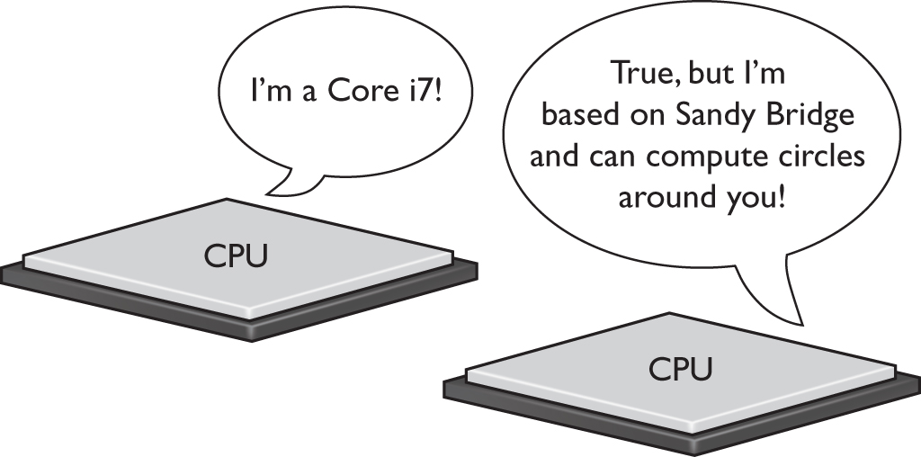
Modern CPUs
Both companies use code names to keep track of different variations within models.
CPUs labeled as the same model may have CPUs inside that are very different from earlier versions.
Figure 4.20 Same branding, different capabilities

Slide 26
Modern CPUs
Mobile devices need to consume as little electricity as possible.
Less electricity consumption extends the battery charge and creates less heat.
Both manufactures have created both mobile and desktop versions of their CPUs.
Saving energy by making the CPU run more slowly when demand is light is called throttling

Slide 27
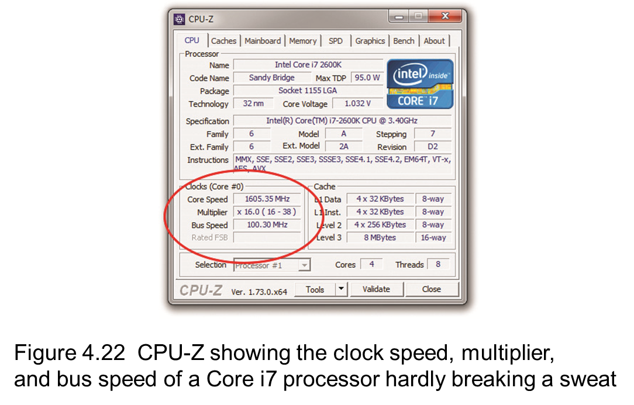
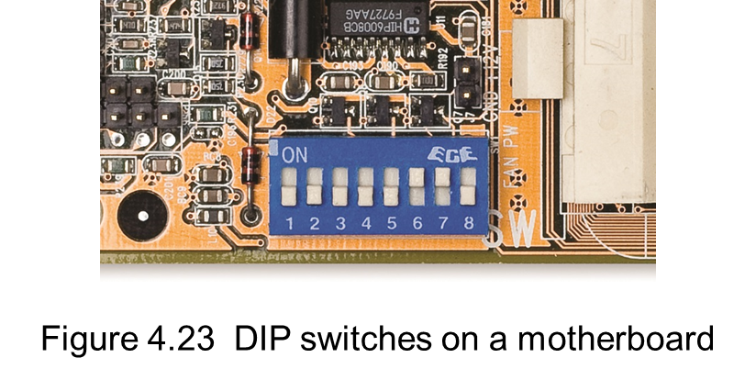
Modern CPUs
All modern CPUs run at some multiple of the system clock speed.
The motherboard is automatically configured for clock speed through a function called CPUID (CPU identifier).
Let’s download CPU-Z and see!
NEW
OLD
Notes:
In class the instructor downloads CPU-Z and then removes the program after showing the class.

Slide 28
Modern CPUs
Notes:
In class the instructor downloads CPU-Z and then removes the program after showing the class.

Slide 29
Modern CPUs
From the era of 32-bit (X86) processors, we are transitioning into 64-bit (x64) processing.
Can run a compatible 64-bit and 32-bit software.
64-bit (x64) supports up to 16 EB (Exabyte) of memory vice the x86’s 4 Gb max.
Capable of running more than one OS at a time
Enables hardware-based virtualization support

Slide 30
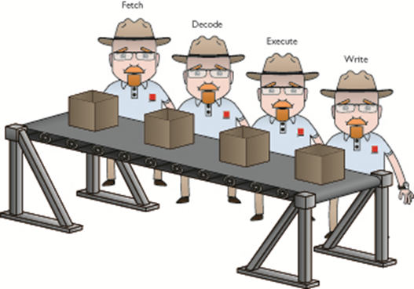
Modern CPUs
CPUs process data in stages called “Pipelining”— at least four steps (stages)
Fetch: Get the data from
the EDB
Decode: Figure out what
type of command needs to
be executed
Execute: Perform the
calculation
Write: Send the data back onto the EDB

Slide 31
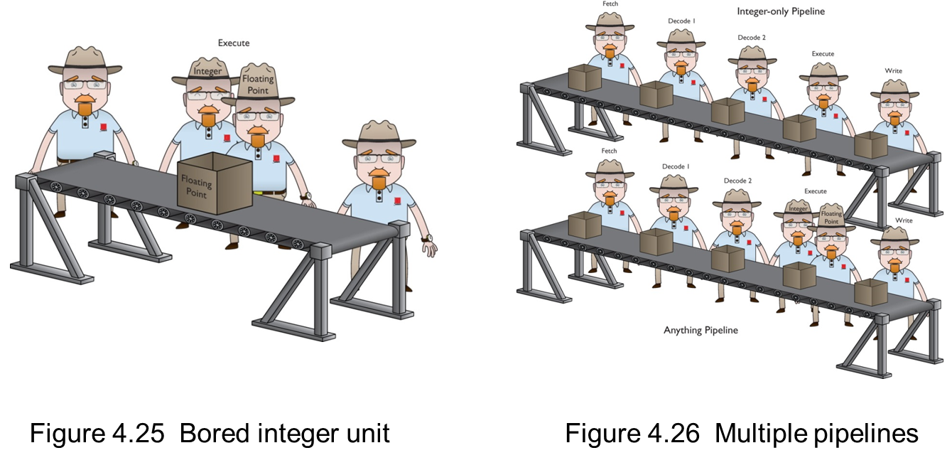
Modern CPUs
Current CPUs have many stages in the pipeline
This subdivided the workload making it more efficient without increasing the clock speed

Slide 32
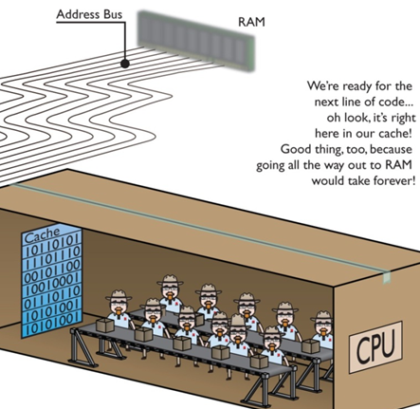
Modern CPUs
A cache called static
RAM (SRAM), reduces
wait states by using
built-in, very high-
speed RAM to preload
many instructions.
Newer CPUs include
three caches (L1, L2, L3)

Slide 33
Modern CPUs
CPUs settings can be modified to improve their efficiency and speed
CPU simulates the actions of a second processor by multithreading.
Enhances efficiency (more than one brain)
Does not increase processing power
Hyper-transport increases the speed data travels on the FSB.
CPUs are also developed as dual and multicore for increased power and performance.
Notes:
CHANGE SLIDES TO MATCH!!!!!!!!!!!!!! Rework the words!!

Slide 34
Modern CPUs
Almost all current microprocessors have an integrated memory controller (IMC)
Moved from the motherboard chip into the CPU to optimize the flow of information into and out from the CPU
Causes different CPUs to require different types and capacities of RAM
Notes:
Manufacturers implement a variety of IMCs in their CPUs. In practice, this means that different CPUs handle different types and capacities of RAM.

Slide 35
Modern CPUs
From CPU to GPU.
Video processing portion of computer tasks handled by the graphics processing unit (GPU)
Can handle certain tasks much more efficiently than the standard CPU
Enhances computer’s overall performance while reducing energy use, size, and cost
Ideal for mobile devices

Slide 36
Modern CPUs

Slide 37
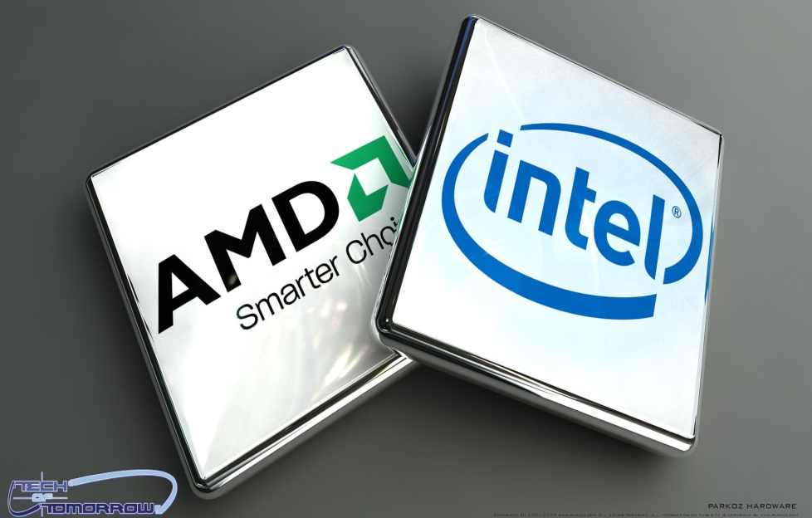
Select and Install a CPUs
As a technician, you will face many challenges such as:
Selecting the proper
CPU
Installing several types
of processors
Troubleshooting

Slide 38
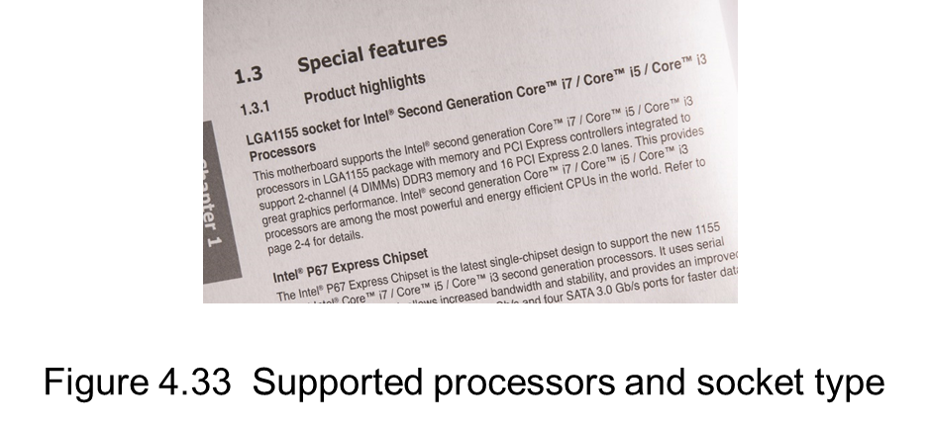
Select and Install a CPUs
Select a CPU the motherboard can support
Intel or AMD
If buying a motherboard with a CPU:
Select CPU appropriate for the intended purpose
Determine the type of socket on the motherboard
Check motherboard
documentation or manufacturer’s
web site
Learn which sockets go with
which family of CPU

Slide 39
Select and Install a CPUs
Table 4.2 | Intel-based Sockets
Socket |  | CPU
LGA 775¹ |  | Pentium 4, Celeron, Pentium 4 Extreme Edition, Core 2 Duo, Core 2 Quad, Xeon, and many others
LGA 1156² |  | Core i3/i5/i7, Pentium, Celeron, Xeon
LGA 1155³ |  | Core i3/i5/i7, Pentium, Celeron, Xeon
LGA 1366⁴ |  | Core i7, Xeon, Celeron
LGA 2011⁵ |  | Core i7, Core i7 Extreme Edition, Xeon
LGA 1150⁶ |  | Core i3/i5/i7, Pentium, Celeron, Xeon
LGA 1151⁷ |  | Core i3/i5/i7, Pentium, Celeron, Xeon
Table 4.3 | AMD-based Sockets
Socket | Pins | CPU
AM3¹ | 941 | Phenom II, Athlon II, Sempron, Opteron
AM3+ | 942 | FX
FM1 | 905 | A-Series²
FM2 | 904 | A-Series
FM2+ | 906 | A-Series
G34 | 1974 | Opteron
C32 | 1207 | Opteron
Notes:
The LGA 775 socket was the only desktop or server socket used for many years by Intel and thus just about every branded Intel CPU used it at one time or another.
Socket LGA 1156 CPUs are based on the pre–Sandy Bridge architecture.
Socket LGA 1155 CPUs are based on Sandy Bridge or Ivy Bridge architecture.
The very first Core i7 processors used LGA 1366. Socket 1366 does not support integrated graphics.
Intel uses LGA 2011 for several generations of Core i7 and Core i7 Extreme Edition CPUs. Socket 2011 does not support integrated graphics. Plus, the retail version does not come with an OEM fan and heat-sink assembly. You need to buy that separately.
Socket 1150 CPUs are based on Haswell or Broadwell architecture.
Socket 1151 CPUs are based on Skylake architecture. Intel had just started releasing the first of these as we went to print. Skylake will not be on the 901 exam.

Slide 40
Select and Install a CPUs
Pay careful attention to:
CPU pins
Power supply
Adequate cooling
Consider whether to leave CPU at stock settings or overclock it

Slide 41
Select and Install a CPUs
Socket types
Intel processors use a land grid array (LGA) package
AMD CPU pins align with socket holes—a pin grid array (PGA)
CPUs and sockets are keyed to help prevent misalignment and incorrect insertion
Zero Insertion Force (ZIF) sockets

Slide 42
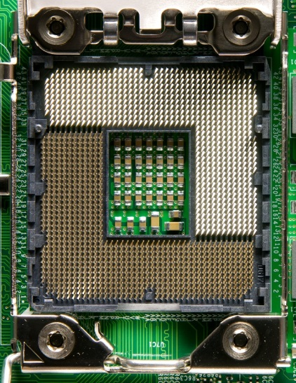
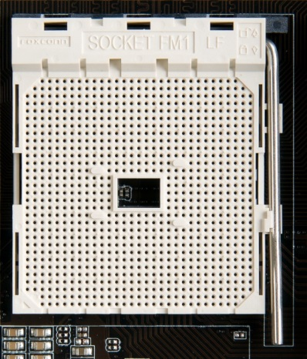
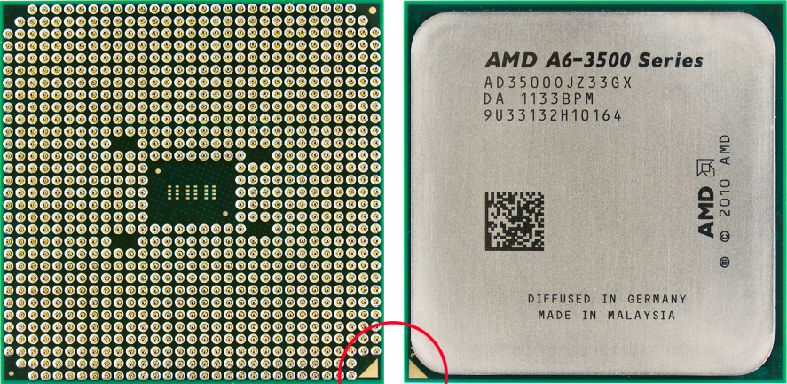
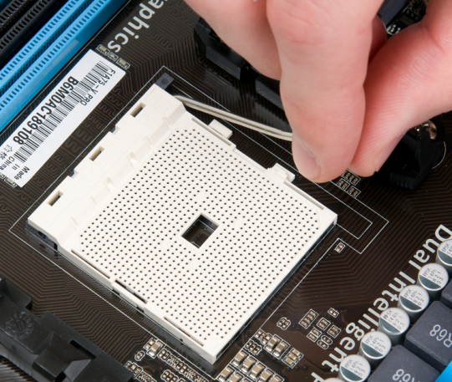
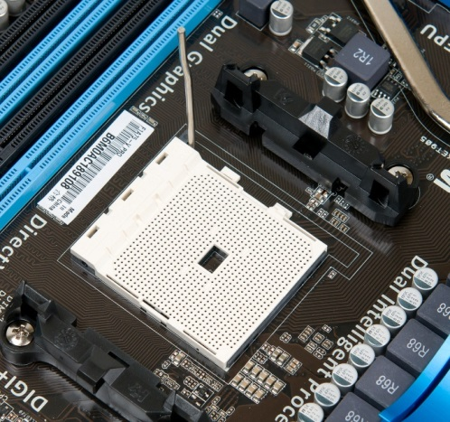
Select and Install a CPUs
Figure 4.35 AMD-based socket without pins
Figure 4.36 Underside and top of a CPU
Figure 4.34 Intel-based socket with pins
Figure 4.37 Moving the release arm
Figure 4.38 Fully opened socket
Notes:
With Intel-based motherboards, the sockets have hundreds of tiny pins that line up with contacts on the bottom of the CPU (see Figure 4.34).
AMD CPUs have the pins (see Figure 4.35); the sockets have holes. The pins on the AMD pin grid array (PGA) CPUs align with the holes in the sockets.
All CPUs and sockets are keyed so you can’t (easily) insert them incorrectly. Look at the underside of the CPU in Figure 4.36.

Slide 43
Select and Install a CPUs
Notes:
With Intel-based motherboards, the sockets have hundreds of tiny pins that line up with contacts on the bottom of the CPU (see Figure 4.34).
AMD CPUs have the pins (see Figure 4.35); the sockets have holes. The pins on the AMD pin grid array (PGA) CPUs align with the holes in the sockets.
All CPUs and sockets are keyed so you can’t (easily) insert them incorrectly. Look at the underside of the CPU in Figure 4.36.

Slide 44
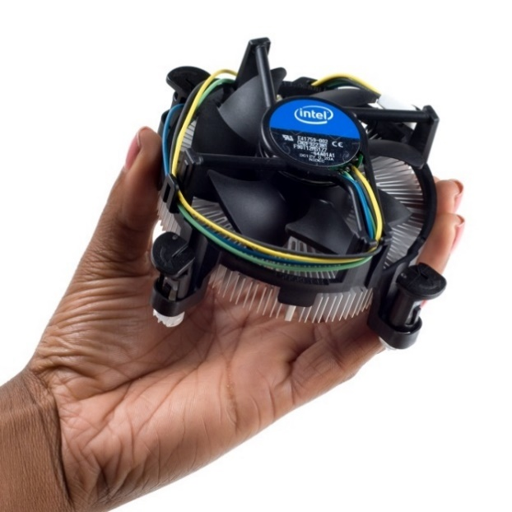
Troubleshooting CPUs
CPUs heat up due to electrical power consumption (wattage).
Most CPUs use a combination of heat sink and fan assembly.
OEM CPU coolers
Heat sink and fan assemblies included with
a retail-boxed CPU
Specialized CPU coolers
Third-party heat-sink and fan assemblies for a
variety of CPUs
Usually exceed the OEM heat sinks in the
amount of heat they dissipate
Figure 4.39 Intel stock heat sink and fan assembly

Slide 45
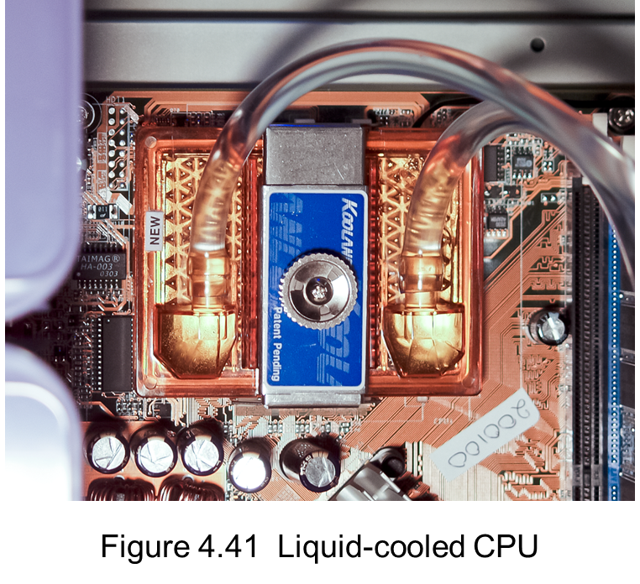
Troubleshooting CPUs
Liquid cooling works by running some liquid (usually
water) through a metal
block that sits on top of
the CPU, absorbing heat.
Apply a small amount of
thermal paste (thermal
compound, heat dope, or
nasty silver goo) to the CPU
before attaching the heat sink.

Slide 46
Troubleshooting CPUs
Running a system at clock speeds higher than the CPU was rated is called overclocking.
Intentional overclocking a CPU immediately voids most warranties and may destroy the CPU.
Overclocking is done through jumpers, CMOS settings, or software configuration.
Usually involves increasing the bus speed for the system and increasing the voltage going into the CPU.
This increase in power draw also increases heat production.
Notes:
Safety Alert
Overclocking voids the warranty on the CPU. It can also make your system unstable and prone to locking up, or it can even destroy the CPU. Added cooling, such as water cooling, might be necessary to keep CPU cool.

Slide 47
Troubleshooting CPUs
Overheating
This condition can cause system to not start or to lockup.
Newer CPUs will usually shut themselves down before overheating.
Most heating problems are due to faulty installation or environmental issues.
Catastrophic failures are not as common as overheating failures

Slide 48
Troubleshooting CPUs
Heat problems to address caused by a faulty installation.
Too much or not enough thermal paste
Failure to connect fan power to the motherboard
Environmental heat or lack of adequate ventilation
Can cause CPU to heat up and shut down

Slide 49
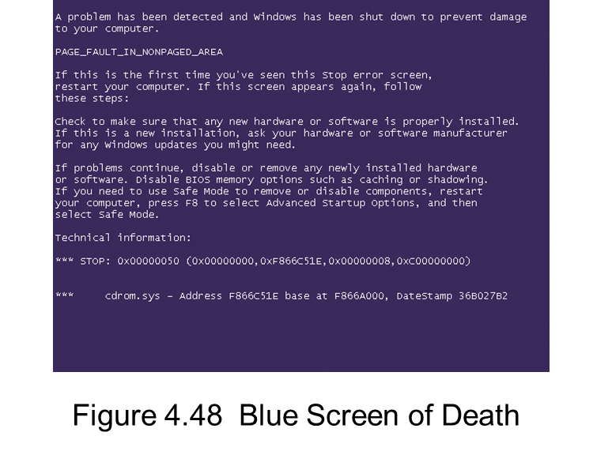
Troubleshooting CPUs
Displays a proprietary crash screen
Window’s Blue Screen of Death (Windows Stop error)
Spinning pinwheel on Mac
OS X
May cause PC to shut
down or go black
May burn components
Next Slide

Slide 50


Slide 51
Troubleshooting CPUs
When effective troubleshooting renders a defective CPU:
Select a replacement CPU
Check the manufacturers
warranty.
Verify the needs of the customer
Upgrade benefit versus cost
Compatibility
Replace with the same model

Slide 52


Slide 53
Summary
Central Processing Unit (CPU) core components
Memory and RAM
Modern CPU(s)
Select and install a CPU
Troubleshoot a CPU

Slide 54


